Slide 1
Boost Unit Testing

Slide 2
Boost Test
A library for writing c++ tests
An XUnit test framework
Boost Software License

Slide 3
Why Use Boost Test
The framework provides a uniform (and well-supported) testing and reporting environment.
Using the framework simplifies the process of creating and maintaining unit tests:
extensible logging, XML and JUNIT outputs for third-party tools (eg. cont. integration)
provide assertion context for advanced diagnostic on failure
powerful and extensible dataset tests

Slide 4
Boost.test vs GTest
Boost.Test | Google Test
Does not support mock object. | Support mock object.
Extended feature with event mechanism not supported. | Extended feature with event mechanism supported.
Does not support distributed machine architecture. | Support distributed machine architecture
Does not provide thread safety while running. | Provide thread safety.

Slide 5
Features
A library for writing c++ tests
A rich set of assertions
User-defined assertions.
Checkpoints.
Value-parameterized tests.
Type-parameterized tests.
Various options for running the tests.
XML test report generation.

Slide 6
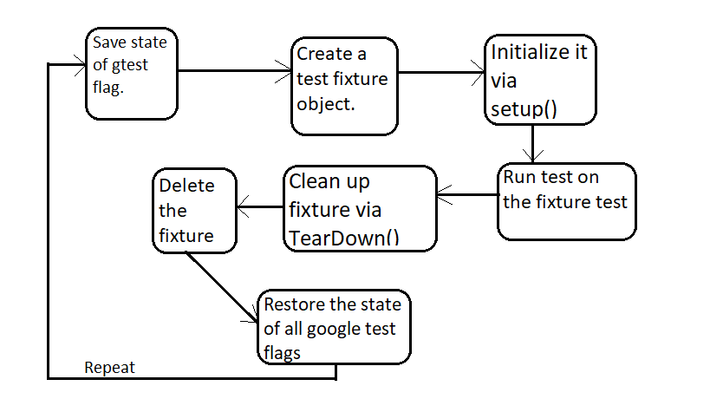
Architecture

Slide 7
Assertions
BOOST_TEST(predicate)
BOOST_CHECK(predicate)
BOOST_WARN(predicate)
BOOST_REQUIRE(predicate)
BOOST_CHECK_EQUAL(val1,val2)
BOOST_WARN_EQUAL(val1,val2)
BOOST_REQUIRE_EQUAL(val1,val2)

Slide 8
Exception Test
These are for verifying that a piece of code throws (or does not throw) an exception of the given type.
No Exception Check:
BOOST_WARN_NO_THROW
BOOST_CHECK_NO_THROW
BOOST_REQUIRE_NO_THROW
Exception Checck:
BOOST_WARN_EXCEPTION
BOOST_CHECK_EXCEPTION
BOOST_REQUIRE_EXCEPTION

Slide 9
Execution Control
--auto_start_dbg (BOOST_TEST_AUTO_START_DBG)
--catch_system_errors (BOOST_TEST_CATCH_SYSTEM_ERRORS)
--log_level (BOOST_TEST_LOG_LEVEL)
--random (BOOST_TEST_RANDOM)
--run_test (BOOST_TEST_RUN_TEST)
--show_progress (BOOST_TEST_SHOW_PROGRESS)

Slide 10
Macros
BOOST_TEST_CHECKPOINT: used to create named checkpoint with message, that will output if error will happen
BOOST_TEST_PASSPOINT: used to create unnamed checkpoint, and if error will happen, then line, where last checkpoint was set, will printed.

Slide 11
Turtle/Fake-It
FakeIt is a simple mocking framework for C++. It supports GCC, Clang and MS Visual C++.
Turtle is a C++ mock object library based on Boost with a focus on usability, simplicity and flexibility.

Slide 12
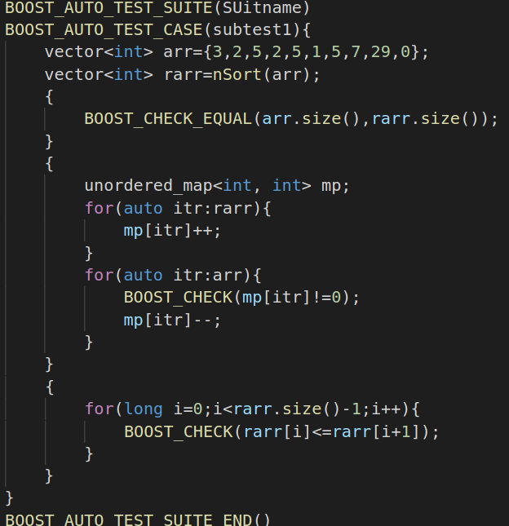
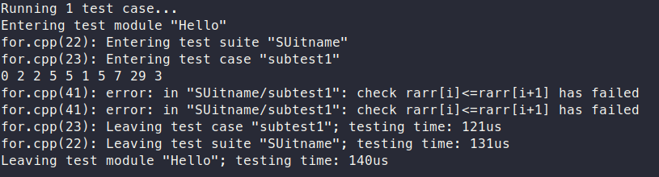
Test Example 1
Add for loop example

Slide 13
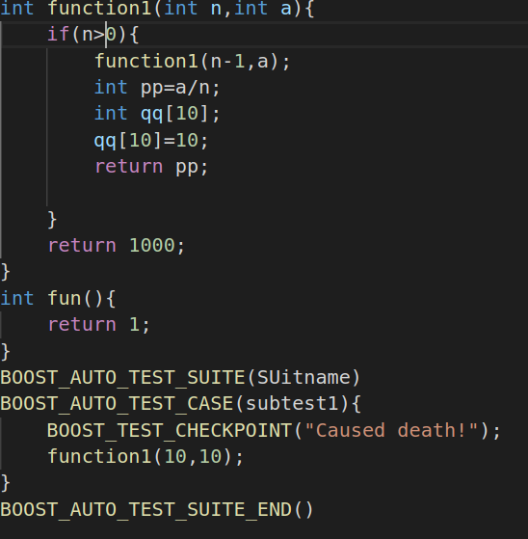
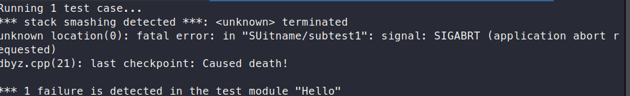
Test example 2
Any other exxample

Slide 14
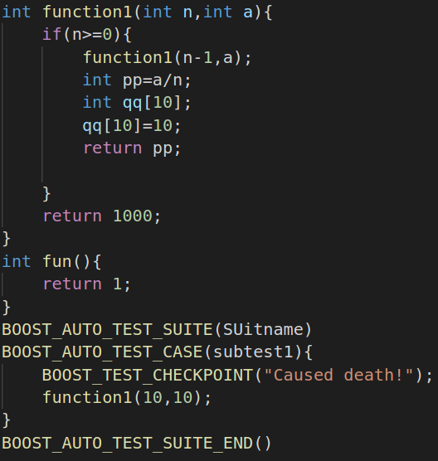
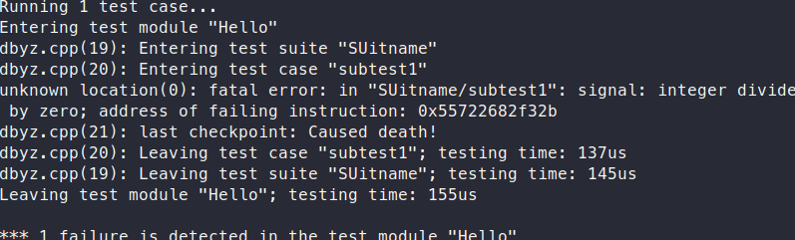
Test example 3
Any other exxample

Slide 15
Limitation
It is not suitable for most multi-threaded tests.
It is not suitable for “one-piece” applications (such as server or CGI). Such applications should be tested via their clients (which would preferably be unit test based).

Slide 16
Platforms
Linux
Mac OS
Windows
Cygwin
MinGW

Slide 17
Requirement
The library is part of Boost.

Slide 18
References
https://www.boost.org/doc/libs/1_45_0/libs/test/doc/html/utf.html
https://www.boost.org/doc/libs/1_45_0/libs/test/doc/html/utf/tutorials.html
https://github.com/boostorg/test
http://alexott.net/en/cpp/CppTestingIntro.html

